Slide 1
ONLINE CAB MANAGEMENT SYSTEM

Slide 2
Contents
Introduction
Objective
Scope
Hardware Requirements
Software Requirements
Model Used

Slide 3
Introduction
Online Cab Management System is a Windows based application that works within centralized network.
This software program provides transportation system, a facility to get a cab to travel without searching it on roads.

Slide 4
Objective
The objective of developing Online Cab Management System is to computerize the traditional way of getting a cab.
The objective of this application is to allow people to hire cab before going to any place at any time.
This allows Passengers to know the details about cab’s driver name, cab number and other things to disallow cheating practices.

Slide 5
Scope
Online Cab Management System has a wide scope since it is a web based software.
It provides convenience for the user to save time and use the system from remote locations.

Slide 6
Hardware Requirements
Processor : Pentium 4 or higher
Processor Speed: 1.7 GHZ
RAM : 256MB
Hard Disk : 80 GB
Device should be equipped with a mouse, display, keyboard.

Slide 7
Software Requirements
Operating System :- Windows XP or Higher
Front End :-NetBeans (V.7.3.1) or Higher
Back End :- MySQL (V 5.0)
Language :- Advanced JAVA

Slide 8
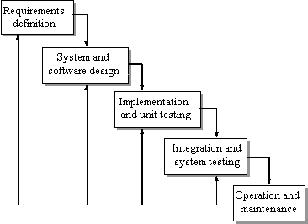
Model Used (Waterfall)

Slide 9
MODULES INVOLVED
ADMIN
CUSTOMER

Slide 10
OPERATIONS PERFORMED
THE DBA WILL PERFORM THE ADD, DELETE AND UPDATE OPERATIONS.
CUSTOMER WILL PERFORM OPERATIONS SUCH AS REGISTRATIONS, EDITING PROFILES, CHANGE PASSWORD AND SENDING LOCATION FROM WHERE TO TRAVEL AND DESTINATION LOCATION.
DRIVER WILL GET CUSTOMER DETAIL AND RECEIVE THAT PERSON.

Slide 11
Thank You

